Slide 1
Chapter 13: I/O Systems

Slide 2
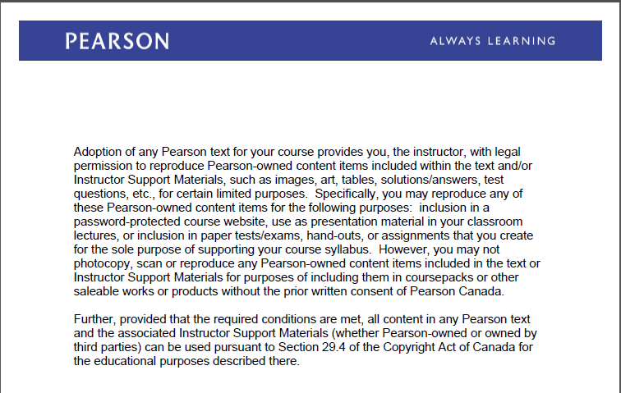
Text Book Slides – Copy Right

Slide 3
Objectives
Explore the structure of an operating system’s I/O subsystem
Discuss the principles of I/O hardware and its complexity
Provide details of the performance aspects of I/O hardware and software

Slide 4
I/O Manager (Subsystem)
The Operating system manages and controls I/O devices and the respective operations
The I/O manager is the heart of the I/O system. It connects applications and system components to devices, and it defines the infrastructure that supports device drivers.
Kernel I/O Subsystem Functions:
  Manages the name space for files and devices
  Access control to files and devices
  Device Allocation
  Configure and initializes device drivers
  Manages buffering, caching and spooling
  Monitors device status
  Handles I/O errors

Slide 5
I/O Devices (Hardware)
Device components
  Device itself
  Device controller – Is hardware (chip, card). Is a collection of electronics that operate port, bus or device.
    The controller can be integrated in the device or it can be a separate circuit board such as host adapter.
  Device Driver - A driver is a software module that interprets high-level commands, such as read or write, and issues low level, device-specific commands, such as writing to control registers. A device driver typically provides an I/O interface for a particular type of device.

Slide 6
Device and Registers
How does the processor passes commands and data to the controller ?
  Each device controller maintains a set of device registers. The CPU can access those registers via special I/O instructions or via memory mapping ( Memory-mapped I/O)
  The processor communicates with the controller by reading and writing bit patterns in the controller’s registers. This communication can occur by:
    Using special I/O instructions ( e.g. in or out) . The I/O instruction moves bits into or out of a device register.
    Another way is via memory-mapped I/O. Device -control registers are mapped into the address space of the processor.
Unix ioctl() is a system call used to send arbitrary bits to a device control register and data to device data register

Slide 7
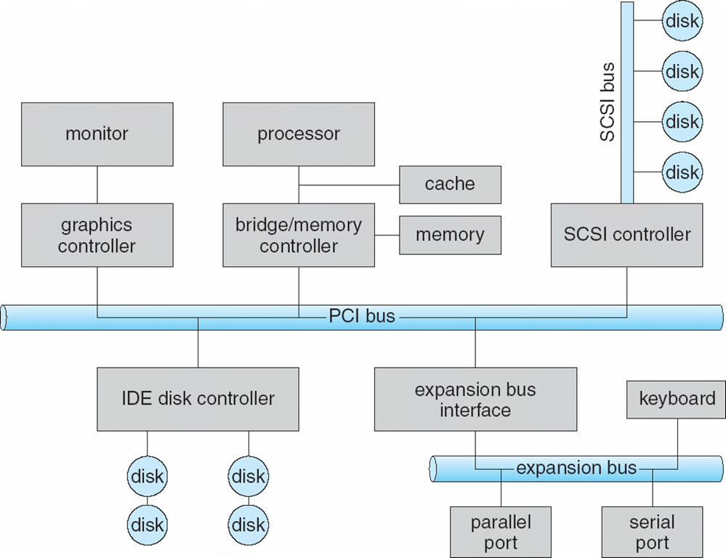
A Typical PC Bus Structure

Slide 8
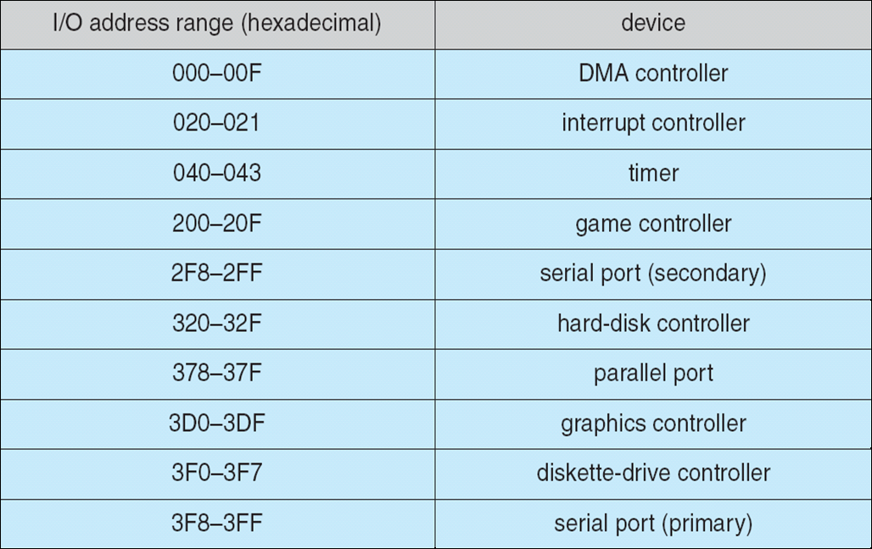
Device I/O Port Locations on PCs (partial)

Slide 9
Polling
The techniques used by the CPU to interact with the device controller are:
  Polling or Busy-wait
  Interrupts:
  When interacting with a device controller, the CPU can wait for a response by polling the status register(s) also known as busy-wait . The CPU periodically checks whether the status of the device has changed. It reads in a loop the status register until the busy bit becomes clear
Busy-wait or Polling technique is good for fast devices but inefficient for slow devices.
Instead of the CPU poll repeatedly for an I/O completion it is more efficient if the hardware controller notify the CPU when the device become ready for service, this hardware mechanism is called an Interrupt

Slide 10
Interrupts
  Modern architectures are interrupt driven. This means that if the CPU requests data from a disk, for example, it does not need to busy-wait until the read is over; it can issue the request and continue with some other execution. When the read is over, the CPU can be interrupted and presented with the read. The CPU is interrupted only when an I/O operation starts and ends .
  The device controller raises an interrupt by asserting a signal on the interrupt request line
  The CPU caches the interrupt and sends it to the interrupt handler
  The interrupt handler clears the interrupt by servicing the device

Slide 11
Interrupts
When an interrupt occurs, the processor sets the pc to a specific memory address. The address is within a special address range called the vector table. The processor suspends normal execution and starts loading instructions from the exception vector table. The entries in the vector table are instructions that branch to specific routines designed to handle a particular exception or interrupt
Interrupt mechanism also used for exceptions such as: dividing by zero, accessing a protecting or non-existing memory address
  Page fault executes when memory access error
  System call executes via trap to trigger kernel to execute request

Slide 12
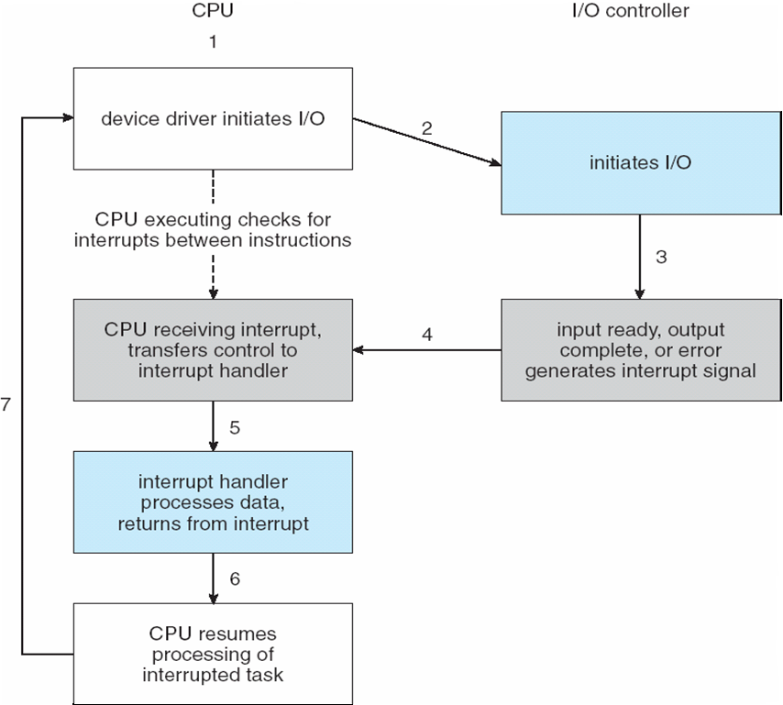
Interrupt-Driven I/O Cycle

Slide 13
Direct Memory Access Structure
Direct memory access (DMA) allows certain hardware subsystems to access main system memory bypassing CPU. Device controller transfers blocks of data from buffer storage directly to main memory without CPU intervention. Only one interrupt is generated per block, rather than the one interrupt per byte
Without DMA, when the CPU is using programed input/output, it is typically fully occupied for the entire duration of the read or write operation, and is thus unavailable to perform other work.
With DMA, the CPU initiates the transfer, does other operations while the transfer is in progress, and receives an interrupt from the DMA controller when the operation is done.
Many hardware systems use DMA, including disk drive controllers, graphics cards, network cards and sound cards.

Slide 14
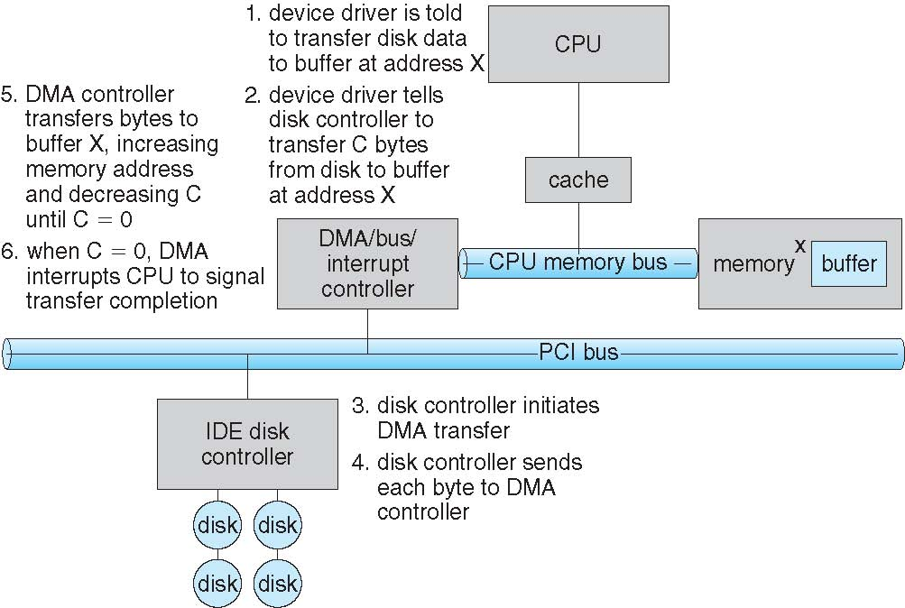
Six Step Process to Perform DMA Transfer

Slide 15
Application I/O Interface
Device-driver layer hides differences among I/O controllers from kernel
Each OS has its own I/O subsystem structures and device driver frameworks
Devices vary in many dimensions:
  Character-stream or block
  Sequential or random-access
  Synchronous or asynchronous (or both)
  Sharable or dedicated
  read-write, read only, or write only

Slide 16
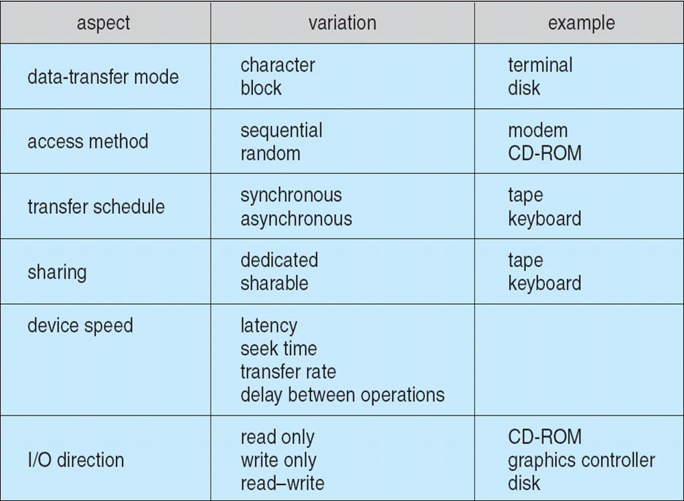
Characteristics of I/O Devices

Slide 17
Linux- Input and Output
In Linux devices can appear as objects within the File system
In Linux devices are treated as files. These files are in the directory /dev
Linux devices are classified into two classes:
  block devices transfer blocks of bytes at a time. Includes all devices that allow random access to completely independent, fixed size blocks of data. Block devices are hard disks, blue-ray discs and flash memory. Block devices usually contain File systems. Commands include read, write, seek .
    When a block is read into memory , it is stored in a buffer . The request manager manages the reading and writing of buffer contents to and from a block device driver
  Character devices transfer data one byte at a time. Character devices include keyboards, mice, serial ports, terminals(tty). Commands include get(), put()
    The kernel performs almost no preprocessing of a file read or write request to a character device, but simply passes on the request to the device.

Slide 18
Unix Major and Minor device number
Unix has a mount table that associates prefixes of path names with specific device names. When Unix looks up the name in the file system directory structures, it finds the <major,minor> device number.
The major device number identifies a device driver that should be call to handle I/O to this device.
The minor device number is passed to the device driver to index into the device table. The respective device-table entry provides the port address or the memory-mapped address of the device controller
When accessing a device file, the major number selects which device driver is being called to perform the input/output operation. This call is being done with the minor number as a parameter and it is entirely up to the driver how the minor number is being interpreted. The driver documentation usually describes how the driver uses minor numbers.

Slide 19
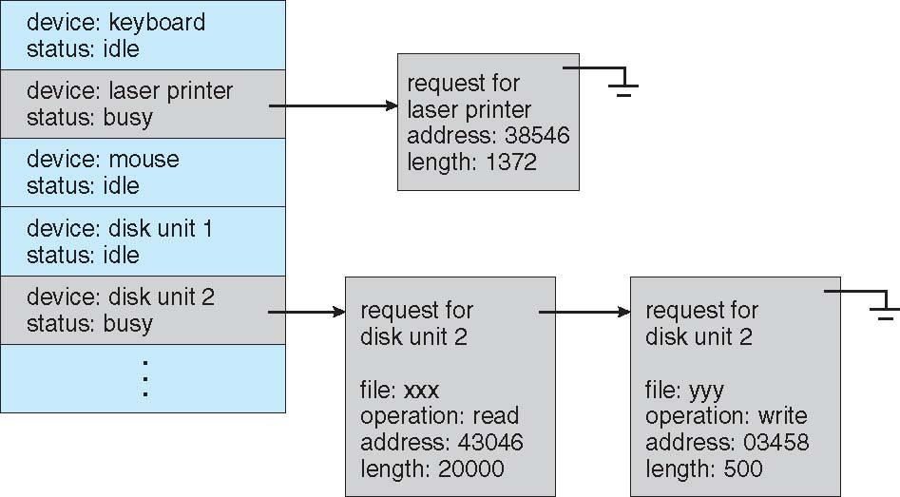
Device-status Table

Slide 20
Kernel I/O Subsystem
Caching – A faster area in memory that holds copy of data
  Always just a copy
  Sometimes this area can be used for buffering
Buffering – A memory area that stores data being transferred between devices
    Copy-on-write can be used for efficiency in some cases
Spooling – Is a buffer that holds output for a device
  The spooling system copies the queued spool files to the printer one at a time

Slide 21
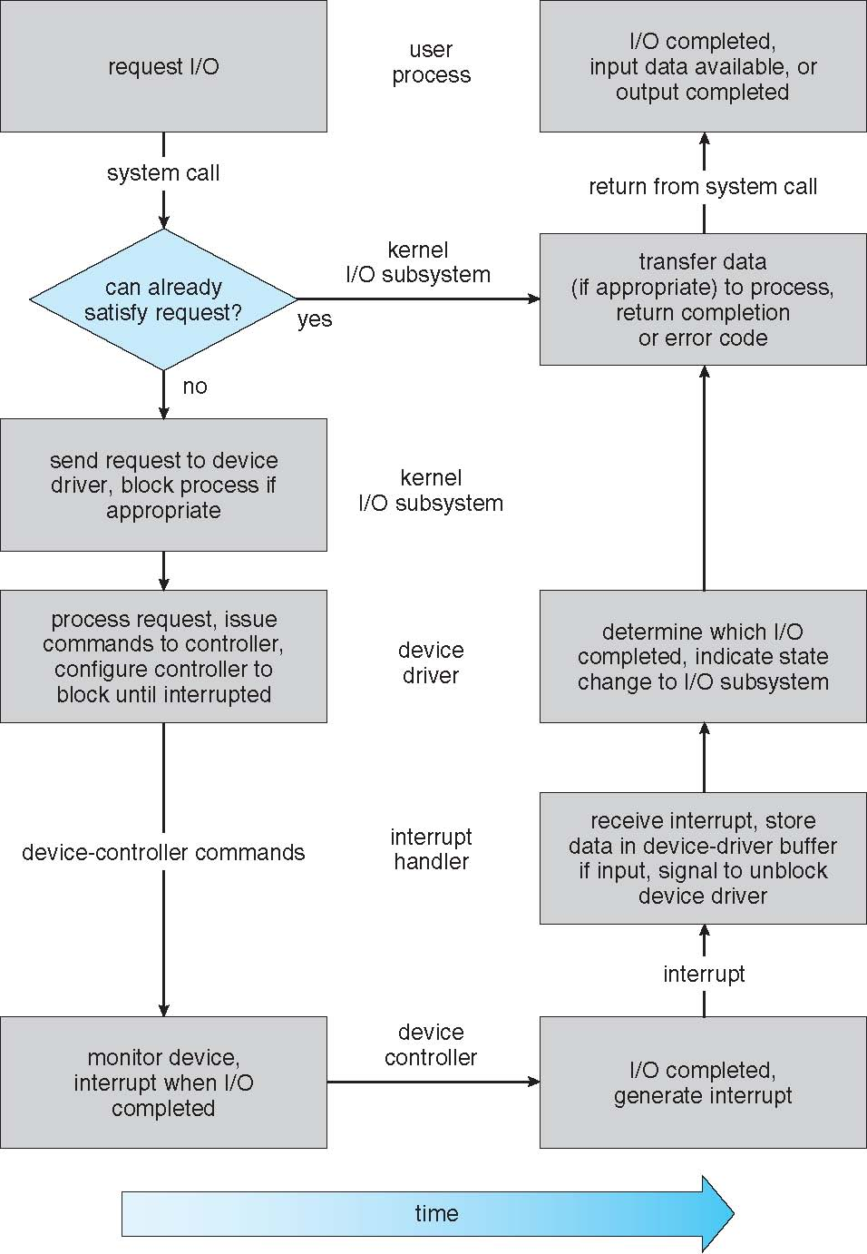
Life Cycle of An I/O Request

Slide 22
STORAGE STRUCTURE

Slide 23

Disk Structure

Slide 24
Magnetic Disk Transfer Rate
The transfer rate is the rate at which data flows between the drive and the system
Transferring data between main memory and disk involves:
  Seek time – Time necessary to move the disk arm (read/write head(s) ) above the appropriate cylinder.
  Rotational latency – Time necessary for the desire sector to rotate the disk head. Wait until the sector that we want to read from is directly below the read/write head.
  Transfer time – The time it takes to perform the actual operation (wait while the requested sectors spin past the r/w head).

Slide 25
Solid-State Disks
Nonvolatile memory used like a hard drive. Flash memory does not lose its contents when the power is removed, which means that flash memory is nonvolatile.
The most common types of flash memory are NOR and NAND. In NOR flash memory each byte is individually addressable, while NAND flash memory is organized into blocks, like a disk. Typically, NOR-type flash memory is used to hold the BIOS on your computer’s motherboard, and NAND-type flash memory is used in SSDs.
It can be more reliable than HDDs
More expensive per MB
Maybe have shorter life span
Less capacity but much faster than magnetic disk and slower than RAM
  Flash memory is significantly faster than magnetic disks (usually by a factor of 100,000, or so; access time: 50 nanoseconds versus 5 milliseconds), but it is slower than RAM (usually by a factor of 50).
No moving parts, so no seek time or rotational latency

Slide 26
Disk Scheduling
The operating system is responsible for using hardware efficiently — for the disk drives, this means having a fast access time and disk bandwidth
Minimize seek time
Disk bandwidth is the total number of bytes transferred, divided by the total time between the first request for service and the completion of the last transfer
OS maintains queue of requests, per disk or device
Several algorithms exist to schedule the servicing of disk I/O requests. The most common are :
  FCFS
  C-SCAN

Slide 27

FCFS

Slide 28
SCAN
The disk arm starts at one end of the disk, and moves toward the other end, servicing requests until it gets to the other end of the disk, where the head movement is reversed and servicing continues.
SCAN algorithm Sometimes called the elevator algorithm
But note that if requests are uniformly dense, largest density at other end of disk and those wait the longest

Slide 29

SCAN (Cont.)

Slide 30

C-SCAN (Cont.)

Slide 31

C-LOOK (Cont.)

Slide 32
Linux I/O Scheduling
Linux default I/O scheduler is called Completely Fair Queueing (CFQ). This algorithm maintains a requests list per process. If two processes are issuing I/O requests , CFQ will keep two separate lists for requests ,one for each process . These lists are maintain according to the C-SCAN algorithm

Slide 33
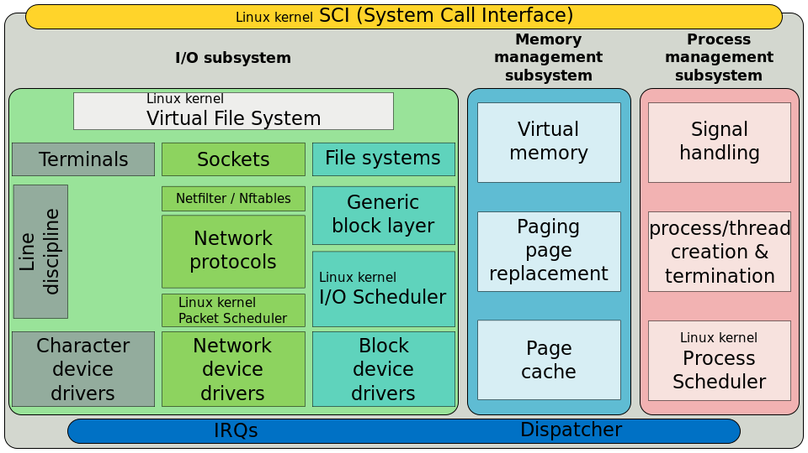
I/O Scheduler

Slide 34
Microcontroller and Microprocessor
https://www.youtube.com/watch?x-yt-cl=84503534&v=7vhvnaWUZjE&x-yt-ts=1421914688

Slide 35
End of Chapter 12

